Slide 1
MOBILE APPLICATION FOR DIET REACALL
BY,
ELITE SAPIENS
Sri Eshwar College Of Engineering.

Slide 2
PROBLEM STATEMENT DESCRIPTION
With the advancement in Technology, mobile applications for diet and weight management is increasing in an exponential manner.
Most of the apps available worldwide provide only the accustomed western diet plans. Besides, some of which don’t have experimented clinical evidence and medical support.
On this context, Ayurveda is the best option that one could dependent on as it analyses underlying root causes and cleanses using natural way ensuring complete cure. However few apps incorporated ayurvedic ways of diet plans, gamification feature is not available.

Slide 3
OBJECTIVES AND KEY FEATURES OF APPLICATION
To build a Best Dietary Chart based on user’s vata, pitta and kapha state.
Application should have a built-in questionnaire based tool through which users can keep a 24/7 track of all food and drink they have consumed earlier.
Application should involve Gamification features which provoke user’s interest.
With Incorporation of AI Based smart food analyzer, application should allow user to keep track of Quantity/Quality/Type of food intake.

Slide 4
GAP ANALYSIS WITH CURRENT SOLUTION
Introduction of AI Chatbot.
AI based customized ayurvedic diet plan based on their regional food available in all major Indian languages.
Graphical representation of food consumed by the user based on their Weekly / Monthly diet report.
Rendering top diet followers with Badges/Points, application captivates more user’s attention.

Slide 5
PROPOSED METHODOLOGY
Identification of state(Vata, Pitta, Kapha) of user’s body through questionnaire based tool.
7. Allow user to keep track of the food consumed with the help of AI based food analyzer
6. Pull in Gamification feature to motivate users
2. Provide Ayurvedic food items according to rasas based on states information acquired from the user
5. Reward users with Badges/Points on successful completion of diet.
8. Graphical Representation of diet completion status of the user
3. Proposed Food items can be shuffled based on user’s accessibility
4. Timely Notification to the user on food intake based on their convenience.
9. Prepare weekly/ monthly report on the amount of nutrients consumed by the users.

Slide 6
USE CASES
User with infirmity can contact experts through Chatbot option.
User who follows improper diet plan will be alerted through warning text or voice messages.
If a user fails to follow the diet plan owing to unavoidable situations, he/she can report to acquire an alternate/convenient diet plan.

Slide 7
DEPENDENCIES & UNIQUENESS
Dosha Identification
Through Questionnaire tool.
Quiz Analysis
Consists of 15 questions
Calculation of the amount of Nutrients consumed
Customized diet plan with individual specific food items.
DEPENDENCIES
Addition of Gamification features to motivate users
Timely Notification to the user on food intake at their convenience
Communication with experts at ease
Based on the doshas, Proposed Food items can be re-ordered based on the availability on that day.
Graphical representation of food consumed by the users
UNIQUENESS

Slide 8
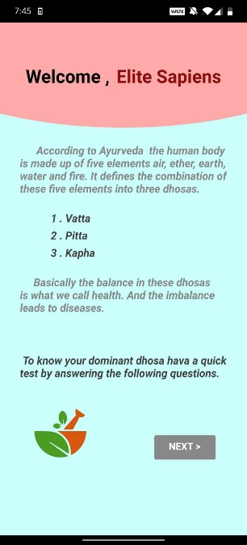
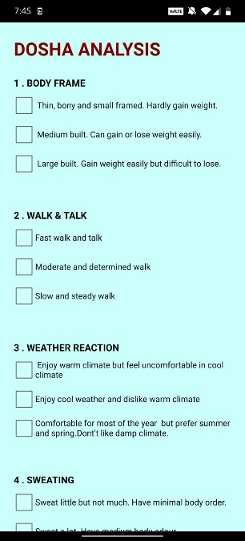
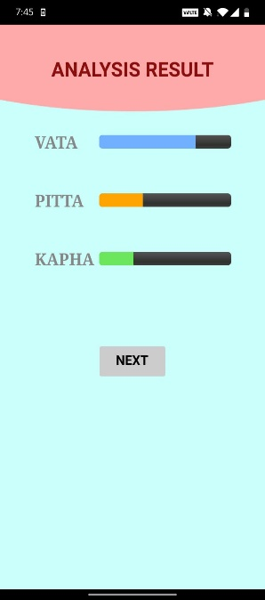
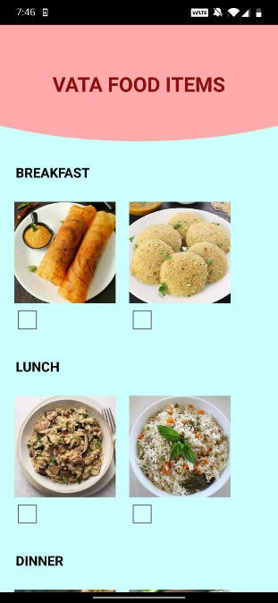
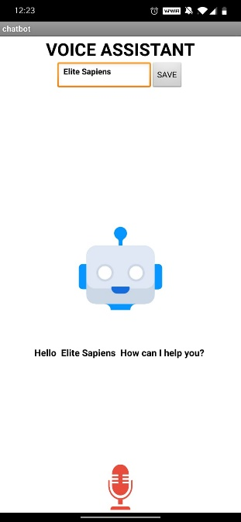
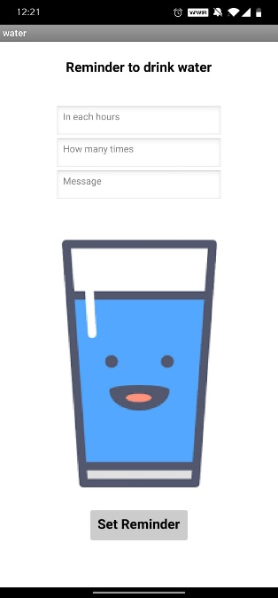
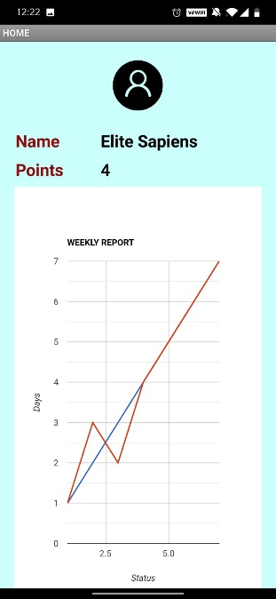
PROTOTYPE AND IT’S CURRENT STATE

